Slide 1
妝模作漾

Slide 2
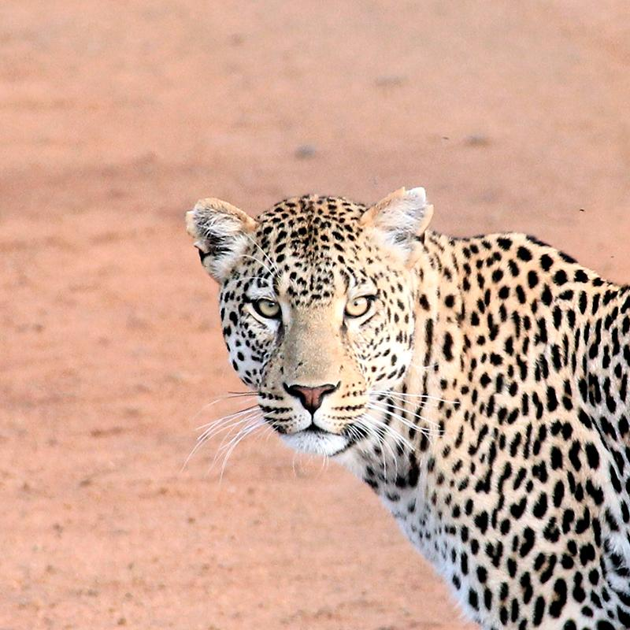
Hello!
I am Jayden Smith
I am here because I love to give presentations.
You can find me at @username
<編號>

Slide 3
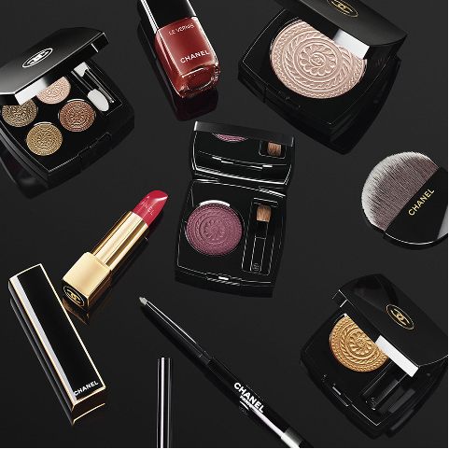
專題發想：
愛美是人的天性，化妝品業更不受景氣影響，根據市場研究諮詢機構調查，台灣化妝品市場產值就達1,200億左右，還在上升。但是，因為商品太多，無從選擇。
網路上從買了什麼產品、膚質、年齡、保養行為，在分享心得裡都鉅細彌遺，而且更棒的是這些資訊都是消費者主動提供。但是，來源複雜，無人整理。
<編號>

Slide 4
目標計畫： 一個從不化妝的新手到... ...想知道流行趨勢的高手都想使用的APP
想學習化妝?
都是受店員推薦,
這樣搭配到底適不適合自己?
買了某項商品,卻不知道怎麼使用?
甚至,從來沒畫過妝,但是想開始嘗試?
熱門與流行在哪?
老王賣瓜自賣自誇,
到底有沒有屬於我的熱門排行?
這一季很流行這種妝容,
但是會適合自己嗎?
該是增進技巧的時候了,
想學最新最熱門的技術...
<編號>

Slide 5
功能介紹
不化妝的新手到...
知道流行趨勢的高手都想使用的APP
<編號>

Slide 6
我的推薦:
提供屬於你的套裝推薦
<編號>

Slide 7
一鍵上妝:
上傳照片，選擇妝容，輕鬆模擬上妝
<編號>

Slide 8
教學文章：
選擇想學習的部位，收刮網路海量資訊
<編號>

Slide 9
情境助手：
提出需求，讓我們把最合適的內容獻給你
<編號>

Slide 10
熱門排行：
專屬於你的排行，或者更多．．．
<編號>

Slide 11
資料流
<編號>

Slide 12
前端架構
<編號>

Slide 13
1
為什麼選擇Django?

Slide 14
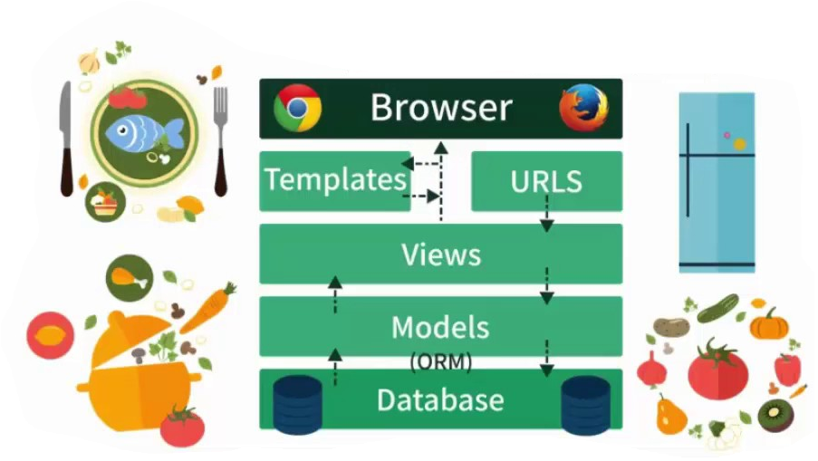
MTV架構 (Models, Templates, Views)
大而不雜
將程式間清楚切開,避免糾結在一起的義大利麵程式碼(spaghetti code)問題，讓每個階層獨立運作,獨立維護!
有效分工,獨立測試
資料庫連結,設定容易
可大可小,系統化管理
<編號>

Slide 15
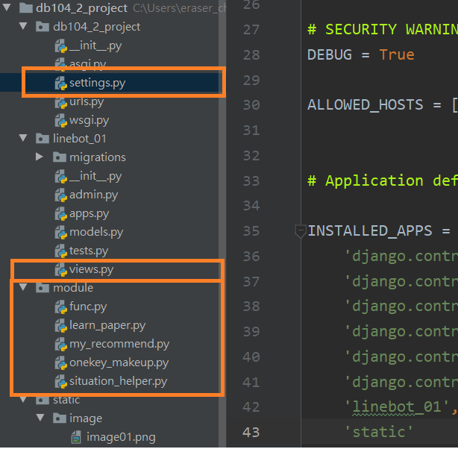
有效分工,獨立測試。
資料庫連結,網頁連結都只要簡單設定。
專案規模可大可小,模組化管理。
<編號>

Slide 16
2
<編號>
為什麼選擇 Line Chat bot?

Slide 17
優勢
依附在通訊軟體,使用者不用安裝不用註冊。
帶給使用者比網頁或APP更親切的使用習慣。
類似於此次時程短且功能較精簡的專案開發,line提供足夠使用的功能介面。
<編號>

Slide 18
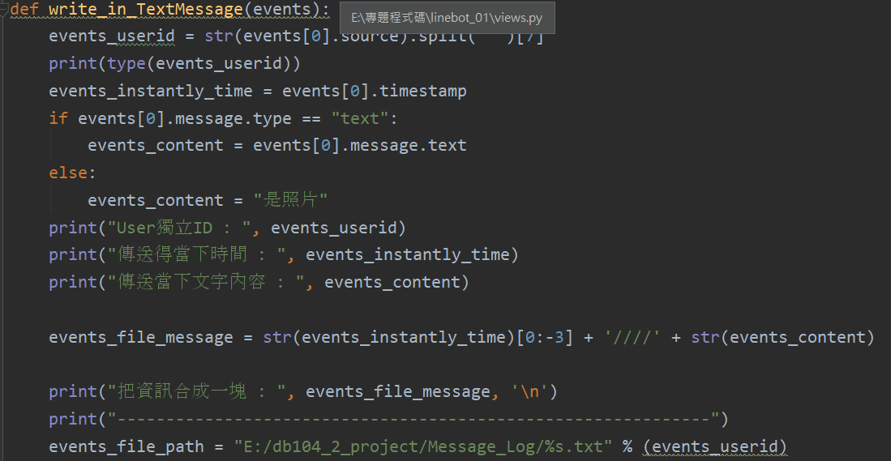
優勢的背後...我們遇到的問題
推薦軟體必須個人化,卻沒有註冊系統?
<編號>

Slide 19
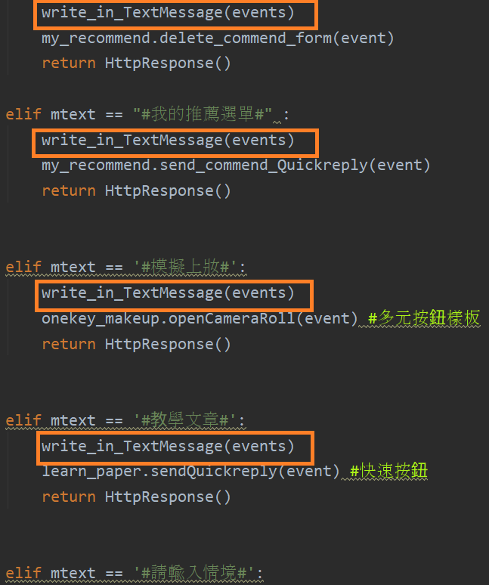
儲存了使用者ID,也記錄了使用者行為,但是我們的需求，不只是文字...
<編號>

Slide 20
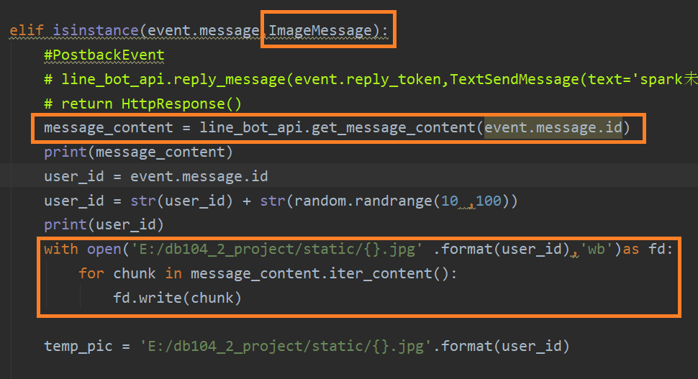
問答式設計
<編號>

Slide 21
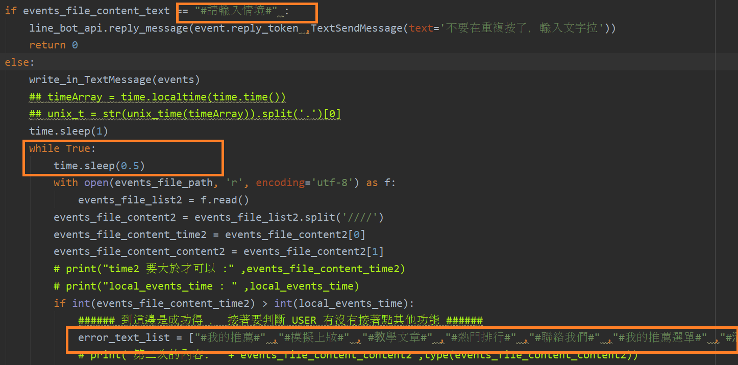
大魔王...問答式設計
<編號>

Slide 22
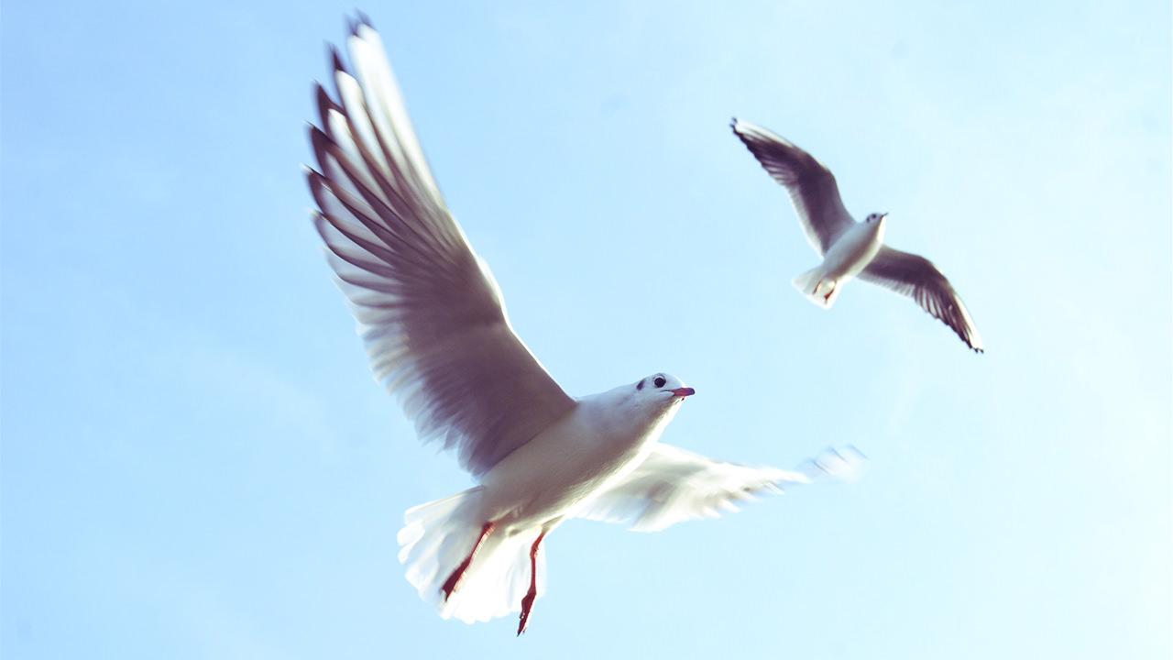
Want big impact? Use big image.
<編號>

Slide 23
優勢的背後...我們遇到的問題
推薦軟體必須個人化,卻沒有註冊系統?
<編號>

Slide 24
MTV架構 (Models, Templates, Views)
大而不雜
將程式間清楚切開,避免糾結在一起的義大利麵程式碼(spaghetti code)問題，讓每個階層獨立運作,獨立維護!
有效分工,獨立測試
資料庫連結,設定容易
可大可小,系統化管理
<編號>

Slide 25
Big concept
Bring the attention of your audience over a key concept using icons or illustrations
<編號>

Slide 26
In two or three columns
Yellow
Is the color of gold, butter and ripe lemons. In the spectrum of visible light, yellow is found between green and orange.
Blue
Is the colour of the clear sky and the deep sea. It is located between violet and green on the optical spectrum.
Red
Is the color of blood, and because of this it has historically been associated with sacrifice, danger and courage.
<編號>

Slide 27
Use charts to explain your ideas
White
Gray
Black
<編號>

Slide 28

Use Diagrams to break down your message
Sample
Text
Sample Text
Sample Text
Sample Text
Diagram featured by http://slidemodel.com
<編號>

Slide 29
And tables to compare data
 | A | B | C
Yellow | 10 | 20 | 7
Blue | 30 | 15 | 10
Orange | 5 | 24 | 16
<編號>

Slide 30
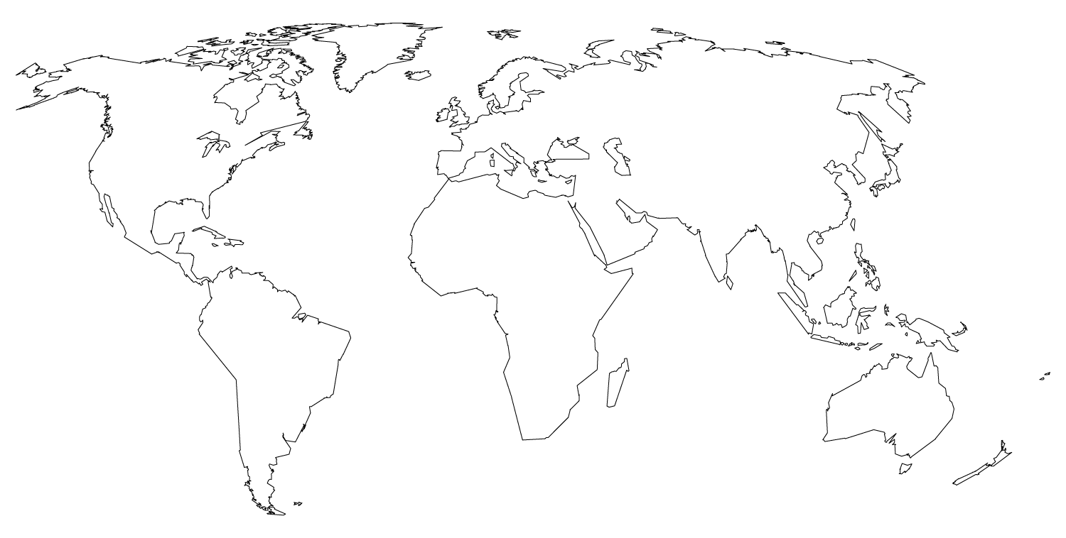
Maps
OUR OFFICE
<編號>

Slide 31
89,526,124
Whoa! That’s a big number, aren’t you proud?
<編號>

Slide 32
89,526,124$
That’s a lot of money
185,244 users
And a lot of users
100%
Total success!
<編號>

Slide 33
Our process is easy
first
last
second
<編號>

Slide 34
Let’s review some concepts
Yellow
Is the color of gold, butter and ripe lemons. In the spectrum of visible light, yellow is found between green and orange.
Blue
Is the colour of the clear sky and the deep sea. It is located between violet and green on the optical spectrum.
Red
Is the color of blood, and because of this it has historically been associated with sacrifice, danger and courage.
Yellow
Is the color of gold, butter and ripe lemons. In the spectrum of visible light, yellow is found between green and orange.
Blue
Is the colour of the clear sky and the deep sea. It is located between violet and green on the optical spectrum.
Red
Is the color of blood, and because of this it has historically been associated with sacrifice, danger and courage.
<編號>

Slide 35
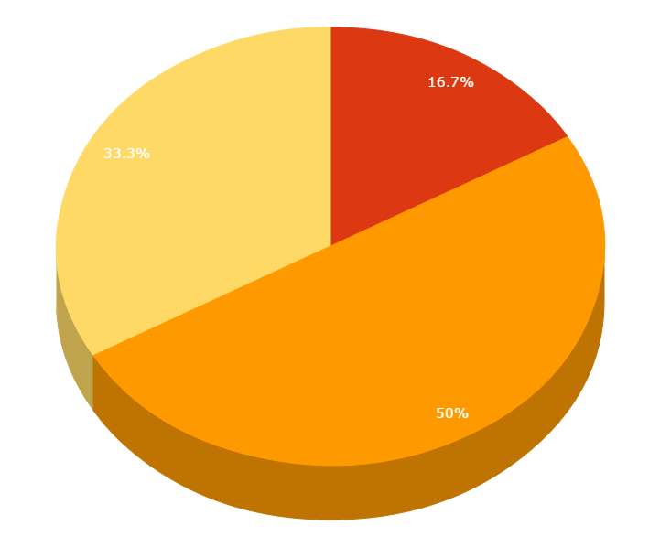
You can copy&paste graphs from Google Sheets
<編號>

Slide 36
Place your screenshot here
Android project
Show and explain your web, app or software projects using these gadget templates.
<編號>

Slide 37
Place your screenshot here
iPhone project
Show and explain your web, app or software projects using these gadget templates.
<編號>

Slide 38
Place your screenshot here
Tablet project
Show and explain your web, app or software projects using these gadget templates.
<編號>

Slide 39
Place your screenshot here
Desktop project
Show and explain your web, app or software projects using these gadget templates.
<編號>

Slide 40
Thanks!
Any questions?
You can find me at @username & user@mail.me
<編號>

Slide 41
Presentation design
This presentation uses the following typographies and colors:
Titles: Nixie One
Body copy: Varela Round
You can download the fonts on these pages:
https://www.fontsquirrel.com/fonts/nixie-one
https://www.fontsquirrel.com/fonts/varela-round
Yellow #f8bb00 Orange #ed4a00 Fucsia #e8004c
Blue #00acc3 Aqua #00d1c6 Lime #bbcd00
Green #65bb48 Gray #617a86 Light Gray #a1becc
You don’t need to keep this slide in your presentation. It’s only here to serve you as a design guide if you need to create new slides or download the fonts to edit the presentation in PowerPoint®
<編號>

Slide 42
Credits
Special thanks to all the people who made and released these awesome resources for free:
Presentation template by SlidesCarnival
Photographs by Unsplash
<編號>

Slide 43
SlidesCarnival icons are editable shapes.
This means that you can:
Resize them without losing quality.
Change fill color and opacity.
Change line color, width and style.
Isn’t that nice? :)
Examples:
<編號>

Slide 44
😉
Now you can use any emoji as an icon!
And of course it resizes without losing quality and you can change the color.
How? Follow Google instructions https://twitter.com/googledocs/status/730087240156643328
✋👆👉👍👤👦👧👨👩👪💃🏃💑❤😂😉😋😒😭👶😸🐟🍒🍔💣📌📖🔨🎃🎈🎨🏈🏰🌏🔌🔑 and many more...
<編號>

Slide 45

Free templates for all your presentation needs
For PowerPoint and Google Slides
100% free for personal or commercial use
Ready to use, professional and customizable
Blow your audience away with attractive visuals

